Slide 1
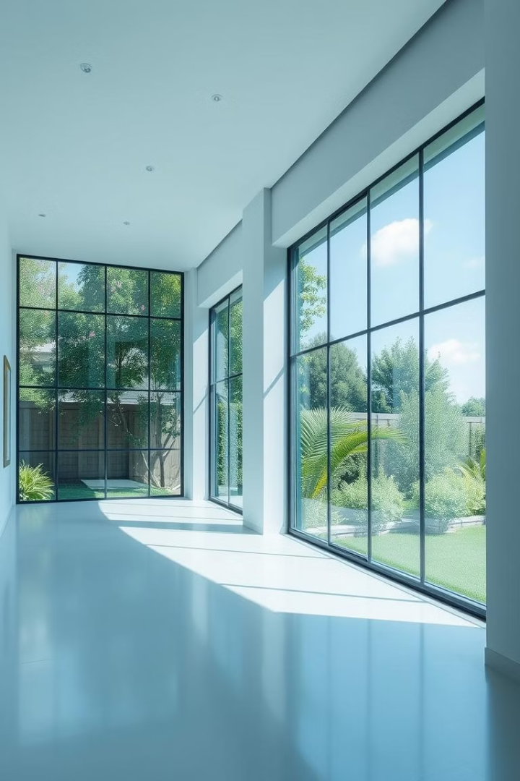
House Rent Application using MERN
Team members:
Saraniya B, Sofiya Rahamath A, Shareen S, Varsha M
B.Tech IT 4th year
Meenakshi College of Engineering
Notes:
1

Slide 2

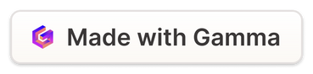
Introduction to the App
Web-based platform for finding and renting properties.
1
User-Friendly Interface
2
Efficient Communication
Seamless navigation and intuitive design.
Connecting renters and landlords easily.
3
Comprehensive Property Listings
Detailed descriptions, photos, and virtual tours for each property.
Notes:
2

Slide 3
Key Features for Success
Streamlined search and rental processes.
Property Listings
Search Filters
Direct Communication
Details, photos, and pricing.
Refine by location, price, type, amenities.
Messaging feature for inquiries and booking.
Notes:
3

Slide 4
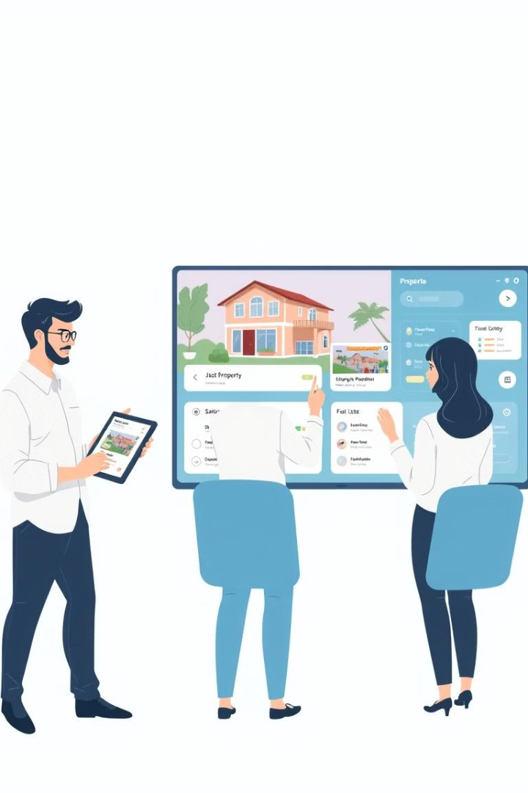
User Roles and Workflows
Distinct workflows for each user type.
User Type
Functions
Renters
Search, inquire, book.
Property Owners
List properties, manage inquiries.
Admins
Platform oversight, account approvals.
Notes:
4

Slide 5
Technical Architecture Overview
MERN stack for robust and scalable app.
Frontend
Backend
React.js, Bootstrap, Material UI.
Node.js, Express.js, MongoDB.
React.js provides a component-based architecture for building user interfaces. Bootstrap provides a responsive and mobile-friendly framework for styling. Material UI offers a pre-built set of components for creating modern and visually appealing interfaces.
Node.js offers a JavaScript runtime environment for building server-side applications. Express.js provides a web application framework that simplifies routing, middleware, and API development. MongoDB offers a document-based database system that scales well with growing data requirements.
Notes:
5

Slide 6
Database Design and Functionality
Optimized for efficient data handling.
Users Collection
Properties Collection
Inquiries and Bookings
Renter and owner profiles.
Details, photos, pricing.
Tracks inquiries, bookings, and statuses.
Notes:
6

Slide 7
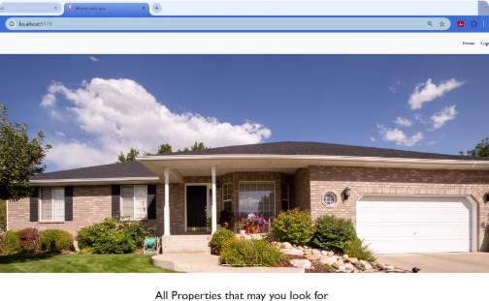
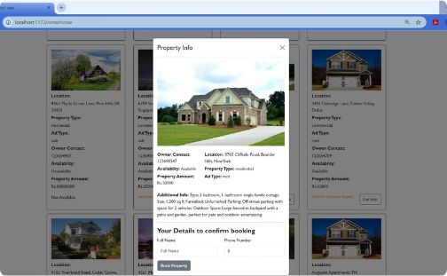
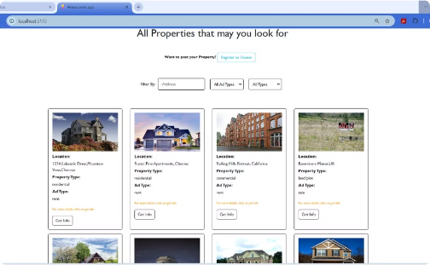
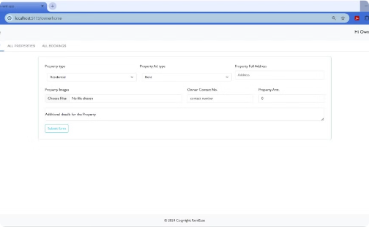
Visualizing the App's Interface
Clean and intuitive user experience.
Home Screen
Property Details
Simple search and browsing.
Comprehensive information.
User Dashboard
Owner Dashboard
Personalized management.
Adding properties.
Notes:
7

Slide 8
Challenges and Solutions Encountered
Overcoming obstacles for smooth operation.
Challenge: Image Uploads
1
Reliable storage and retrieval.
2
Solution: Cloud Storage
Efficient image management.
Challenge: Real-Time Notifications
3
Instant updates for users.
4
Solution: Web Sockets
Real-time communication.
Challenge: Scalability
5
Maintaining performance with growth.
6
Solution: Database Indexing
Optimized search speed.
Notes:
8

Slide 9
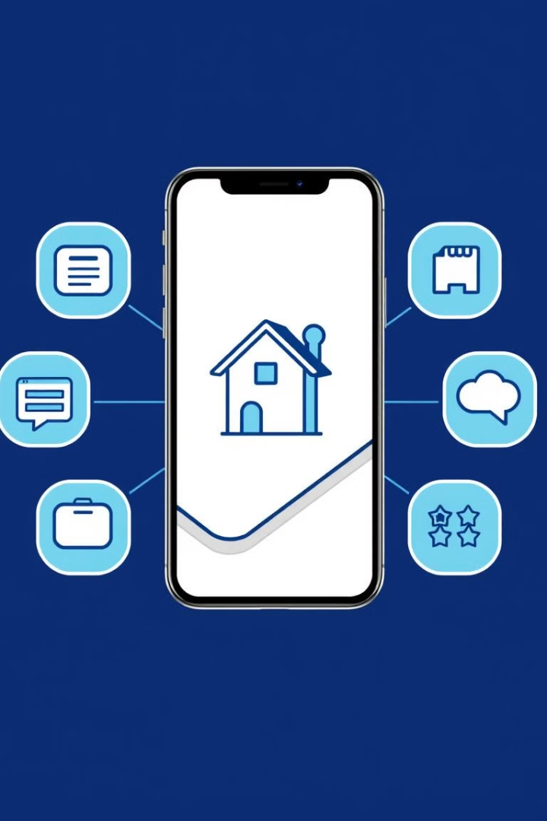



Future Enhancements
Future features for added value.
Integrated Payments
Seamless rent transactions.
AI Recommendations
Personalized property suggestions.
Real-Time Chat
Direct communication between users.
Notes:
9

Slide 10




Conclusion and Benefits
Unified platform for a smooth rental experience.
Simplified Process
Efficient search, inquiry, and booking.
MERN Stack
Scalable and user-friendly technology.
Transparency and Security
Trustworthy rental experience for all.
Notes:
10

